Slide 1

Updates
Michelle Nienhius, MPH
Manager, Division of Prevention and Intervention Services
November 2, 2023
Notes:
Custom DAODAS color codes is : Red-0
Green-131
Blue-139

Slide 2
Topics Addressed:
CTC Survey
Synar Study
Campaign Updates
Training/Resources

Slide 3
Communities That Care Survey
Timeline and Reminders

Slide 4

South Carolina Department of Alcohol and Other Drug Abuse Services
Overview of CTC Survey
SC CTC Survey administration dates are January 22 – March 25, 2024.
Schools will have the opportunity to add up to four locally determined questions to their survey.
  Additional questions must be submitted to DAODAS by November 17, 2023
Training and technical assistance will be available.
DAODAS will be the sole fiscal agent of the 2024 SC CTC Survey, and will issue payment to the survey vendor for survey administration.
Survey will be conducted via Survey Monkey for those participants that will be completing the survey online. Paper/pencil surveys will only be available by request.

Slide 5
South Carolina Department of Alcohol and Other Drug Abuse Services
Overview of CTC Survey
The number of schools that are recommended to participate depends on the size of the district. School districts with:
  1-3 schools must administer the survey in at least 1 school.
  4-6 must administer the survey in at least 3.
  7-9 must administer the survey in at least 5.
  10-12 must administer the survey in at least 6.
  more than 12 HS must administer the survey in at least 8.

Slide 6
South Carolina Department of Alcohol and Other Drug Abuse Services
CTC Survey Administration & Plan
Simplest Approach - Survey entire middle and high school student body.
  Otherwise, recommendation is to survey at least 7th, 9th and 11th grade students.
Sites are encouraged to go beyond their 2022 sampling plan (those who conducted CTC previously) to include more schools and grades when possible.
At minimum, surveying the same schools and grades that they did in 2022 would ensure stronger data comparisons.

Slide 7
Timeline
South Carolina Department of Alcohol and Other Drug Abuse Services
June 30, 2023
Wave 1: Survey recruitment at local level-confirm participation with DAODAS
June 16- August 3, 2023
DAODAS provides County Alcohol and Drug prevention staff the new draft survey to review with school officials. Feedback to DAODAS by August 3
October 31, 2023
Wave 2: Survey recruitment at local level-confirm participation with DAODAS
November 17, 2023
December 4-8, 2023
Additional questions to be added to school-specific surveys
Initial Survey administration instructional training

Slide 8
Timeline
South Carolina Department of Alcohol and Other Drug Abuse Services
January 8-12, 2024
Final/follow-up survey administration instructional training
January 12, 2024
All survey administration instructions e-mailed to named contact in each county.
January 22-March 15, 2024
Survey administered to students.
April-May 2024
May 2, 2024
Quality Control and analytic period
Highlights from State report provided at May Prevention Quarterly Meeting

Slide 9
South Carolina Department of Alcohol and Other Drug Abuse Services
Contact Information
Who to contact for more information
  Michelle Nienhius, Prevention Division Director at mnienhius@daodas.sc.gov

Slide 10
Synar Study-Timeline and Reminders

Slide 11
FY2024 Synar Important Dates and Instructions
Group 1: Regions 1 and 4
Pre-YATS Tasks - Group One (Regions 1 and 4) | Deadline
Provide the name, email address and phone number for the Synar Study Coordinator and Back-up coordinator for your county(ies). Email to Prevention@daodas.sc.gov | 10/20/2023
Complete the mandatory Annual Synar Training and email the Prevention@daodas.sc.gov the training completion certificates (with your names printed or signed on the certificates) | 10/23/2023-11/10/2023
YATS Timeframe - Group One (Regions 1 and 4) | Deadline
Outlet Verification (start recruiting youth and adult volunteers during this time) Outlet list will be provided by November 2nd at the Prevention Quarterly Meeting | 11/27/2023
Complete the Synar Study | 12/11/23-2/29/24
Request an extension due to extenuating circumstances | 2/15/2024
Send all YATS forms to DAODAS at 1801 Main Street, 12th Floor, Columbia, SC 29201 (see the Synar Manual); postmarked by: | 3/8/2024

Slide 12
FY2024 Synar Important Dates and Instructions
Group 1: Regions 2 and 3
Pre-YATS Tasks - Group Two (Regions 2 and 3) | Deadline
Provide the name, email address and phone number for the Synar Study Coordinator and Back-up coordinator for your county(ies). Email to Prevention@daodas.sc.gov | 1/12/2024
Complete the mandatory Annual Synar Training and email Prevention@daodas.sc.gov the training completion certificate (with your name printed or signed on the certificate) | 1/15/24-2/2/24
YATS Timeframe - Group Two (Regions 2 and 3) | Deadline
Outlet Verification (start recruiting youth and adult volunteers during this time). Outlet list will be provided by February 1st at the Prevention Quarterly Meeting | 2/26/2024
Complete the Synar Study | 3/11/24-5/24/24
Request an extension due to extenuating circumstances | 5/10/2024
Send all YATS forms to DAODAS at 1801 Main Street, 12th Floor, Columbia, SC 29201 (see the Synar Manual); postmarked by: | 6/3/2024

Slide 13
During the initial review process, if the coordinator has reliable knowledge that an outlet does not sell cigarettes and/or ENDS (electronic nicotine delivery systems), the outlet could be marked for non-consideration and replaced. All outlet exclusions must be confirmed with a phone call or a physical site visit to ensure the business does not sell tobacco products. If an outlet is deemed not to sell cigarettes and/or ENDS, inform DAODAS by November 27, 2023 (Regions 1 and 4) or by February 26, 2024 (Regions 2 and 3) to receive a replacement outlet.
DAODAS continues to require that two adults are used for each inspection team: one to be in the establishment during the entire time the youth is in the establishment and one to remain in the car.
The Synar forms will be scanned, so it’s important be neat-do not make any extra marks on the form. Instead of marking freely on the forms, we ask you to include one overall coversheet with any changes, such as changes in store addresses or store names.
Multi-county agencies may only count adult or youth volunteers one time for reimbursement purposes, even if they are used in multiple counties.
Mileage is only reimbursable for personal vehicles, not for agency vehicles.
Questions? E-mail: prevention@daodas.sc.gov

Slide 14
Only young people ages 16-20 will be used in this study. You should come very close to dividing your purchase attempts within the age group assigned to your agency (either 16-17 or 18-20). DAODAS will provide which age group your county will be using for inspection.
If a county has two or less outlets to survey, the checks should be completed by two different youth-one male, one female and the youth should be different ages (one 16/one 17 for example).
If a county has three or more outlets, the checks should be equally divided among ages and genders. In other words, a county doing 20 checks should have 5-6 checks done by 18-year old’s, 5-6 checks done by 19-year old’s, and 5-6 checks done by 20-year old’s.
The number of purchase attempts should also be equally split by gender: equal number of checks done by males and females. In the event your youth volunteer does not identify as male or female, please mark this youth as non-binary on the YATS form. If the youth identifies as a gender different from that on their license/ID, please mark this youth as the gender with which they identify.
The race of the youth buyer for each inspection should be based on the demographics of the community. Do not use a White buyer for a predominantly Black or African American neighborhood or vice versa. For a community with a relatively equal mix, you have flexibility in your buyer race.

Slide 15
Multi-county agencies must apply their age/gender balance guidelines across each county and not by agency.
Failure to meet these demographic requirements will result in your county forfeiting its Performance Bonus or perhaps being only reimbursed for cigarette and mileage expenses if these requirements are willfully ignored. Multiple counties do not receive their bonus each year due to failure to meet this standard.
Conduct visits on weekends, during after-school hours, and holidays.
Do not use official cars or cars marked with agency or business name. Park the car out of line of sight by clerks or managers in establishment (especially when visiting convenience stores and gas stations).
Youth should be instructed to be honest with the clerks and not lie about their age, submit a fake ID, claim the cigarettes/ENDS are for a parent in the car, claim their ID is in the car, or mislead the clerk in any other way. The rules of engagement must preclude the common charge of “entrapment” while clearly establishing the merchant’s inclination to sell cigarettes/ENDS to underage youth.
Establish time and place for teams to meet after data collection is over for the day. Set a time to return and meet for the debriefing.

Slide 16
Your agency will receive $30 for each adult and youth volunteer (not staff) you worked with to conduct the study. You have discretion as to what to do with that $30/volunteer.
For legal and liability reasons however, do not pay the youth or adult volunteers any of the $30 in the form of cash or check. Doing so may establish an employee/employer relationship subject to obligations and benefits inherent in such a relationship.
Staff does not count as adult volunteers for the purposes of reimbursement.
****Multi-county agencies may only count a youth or adult volunteer for reimbursement purposes one time total if the same person is used in multiple counties.****
Which brand of cigarettes/ENDS should be requested?
Request Newport, Marlboro or Camels for cigarettes
Request VUSE, NJOY, BLU, PUFF, EFL, or HYDE for ENDS
Make copies of data collection forms, youth master list, adult master list, parent permission forms, expense report, and Checklist before sending originals to DAODAS.
Synar Manual for FY2024 will be posted on SC Documents website: https://ncweb.pire.org/

Slide 17
                Campaign Updates

Slide 18
Open Conversations Campaign:
Planning Kick-off event/press conference- hoping this will occur before Thanksgiving
Campaign items are “EMBARGOED” until the kick-off event. Please DO NOT distribute them in your communities until after the kick-off event has been held by DAODAS
Items to pick-up today include:
Palm cards
Keychains
Stickers
Magnets
DAODAS and Chernoff Newman will also be sending out via mail 400,000 postcards to South Carolina parents once the campaign launches. DAODAS will advise county agencies when postcards are sent out
Main components of the campaign- webpage, resources on DAODAS website, videos, conversation starters and family activities.

Slide 19
Conversation Jar (strips of paper)
Make it easier to talk honestly and openly with your child or teen – especially about the dangers of drugs, alcohol, tobacco, and vaping. Just print this sheet, cut out the conversation starters and put them in a jar. You can even decorate the jar with your kids. Then, pick conversation starters and discuss them or act them out. Remember to listen without interrupting. You can use the Conversation Jar during meals, a quiet time during the day, or even at commercial breaks on TV. Not all of these conversation starters are about alcohol and drugs. The point is to make short, frequent talks easier and more comfortable.
Conversation Cards (deck of cards)
Every parent knows it’s tough to talk to their kids about alcohol, drugs, tobacco, and vaping. These Conversation Cards help make conversations easier – and fun. Carry them with you so you and your kids can pick any card, read the conversation starter out loud, and then discuss. Remember to listen without interrupting. The more short talks you have, the easier it gets and the more comfortable your kids will be when talking with you.
Backpack Conversations (like post-it notes)
Make it easier to talk to your kids about alcohol, drugs, tobacco, and vaping at an early age – or any age. Cut out these conversation starters and put one in your child’s school backpack or lunch a couple times a week. Then, find a good time to talk about whatever is on the conversation starter. Not all of them are about alcohol and drugs. The point is to make short, frequent talks with your kids easier and more comfortable

Slide 20
DAODAS Conversations Pre-wave Study September 2023 conducted by Chernoff Newman
Quantitative, online statewide survey of South Carolina residents who are the parent or guardian of a child/children between the ages of 8 and 17.
The study was conducted between September 6 and 19, 2023.
Study was designed and conducted to serve as a benchmark for the Conversations campaign.
In addition to exploring the conversations parents are having with their children about a number of topics, including but not limited to, alcohol, drugs and vaping, the study explores awareness and perceptions around “fake pills” and fentanyl.
Findings are based on a total sample size of 515, with a correspondent sampling error of +/- 4.2 percentage points at the 95% confidence level. Quotas were put into place to ensure the sample is demographically and geographically representative

Slide 27
EXECUTIVE SUMMARY
Parents are clearly concerned about their children being offered or taking drugs (65% concerned), drinking alcohol (53%), vaping (51%) and/or developing substance misuse problems (49%).
Interestingly, parents of younger and parents of older children express similar levels of concern on these issues. The majority (56%) of parents feel the best time to begin having conversations with their children about alcohol, drugs, vaping and substance misuse is between the ages of nine and 12.
It is encouraging to see that 94% of parents have spoken to their child/children about alcohol, drugs, vaping and substance abuse at least once. Even more encouraging, 100% of parents with children between the ages of 15 and 17 have spoken to their children about these issues.
While parents tend to be more familiar with fentanyl than “fake pills”, very few parents say they are “not familiar at all” with either. That being said, the percentage of parents who say they are “very familiar” with fentanyl (33%) and fake pills (25%) is somewhat low given the prevalence and seriousness of both. For example, only 25% say they are very familiar with “fake pills”, but 70% of parents say they think it would be somewhat or very easy for kids to buy “fake pills”. In addition, many parents say it is somewhat or very common for their child’s/children’s friends and peer group to take drugs that are not prescribed to them (35%), buy drugs through social media (26%) or buy drugs online (25%).

Slide 28
Training/Resources

Slide 29
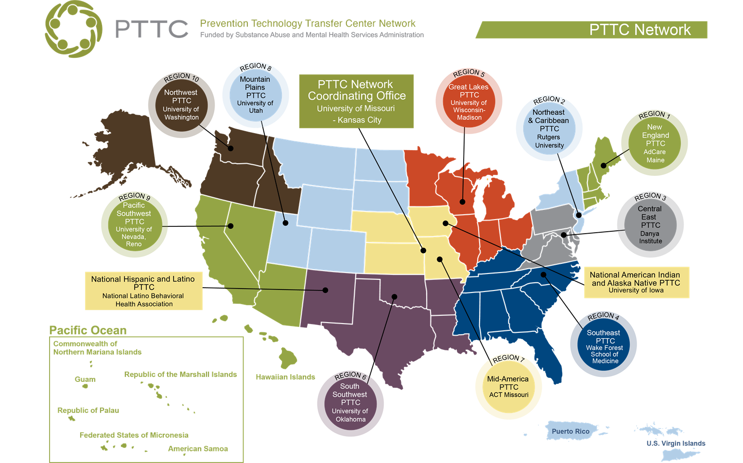
The purpose of the Prevention Technology Transfer Center (PTTC) Network is to improve implementation and delivery of effective substance use prevention interventions, and provide training and technical assistance services to the substance misuse prevention field.

Slide 30

Free Online Learning & Low-Cost Continuing Education for Health and Behavioral Health Professionals
Create an account and begin accessing courses
https://healtheknowledge.org/
The following slides are just a sampling of the many courses available on the website-login to discover these and many more!
https://healtheknowledge.org/course/index.php?categoryid=89

Slide 31
Prevention Specialist Performance Domains
The success of prevention efforts in the community is dependent on a competent, well-trained, ethical and professional Prevention Specialist. Therefore, the purpose of this 3 hour training program is to enhance the quality of services provided as well as the knowledge and skills necessary to become a Certified Prevention Specialist (CPS).
The Social Determinants of Health
The aspects of life that influence a person’s health, including their likelihood of engaging in risky behavior such as substance use, are numerous and varied. They range from very immediate, personal characteristics to overarching societal trends and conditions. The social determinants of health are these larger social or environmental aspects that influence us, such as the economic status of the neighborhoods in which we live, our access to quality health care services, and the amount of discrimination we face. This three-part, 3 hour, self-paced course will provide a comprehensive overview of the social determinants of health and examine the influence they have on substance use. It will also discuss the impacts a public health approach can have on them, review how to turn prevention knowledge into actionable processes, and provide recommendations on how to address them through the principles of prevention science and using environmental and other strategies.

Slide 32
Introduction to the Prevention Core Competencies
The Introduction to Prevention Core Competencies for Prevention Professionals was designed to introduce practitioners to the essential competencies, knowledge, and skill to work in substance use and misuse prevention. It is based on the Prevention Core Competencies published by the Substance Abuse and Mental Health Services Administration (SAMHSA). The course provides a foundation for service delivery based on prevention science and the use of evidence-based practices. It strengthens the understanding of effective planning and implementation approaches and encourages the pursuit of more specialized training and professional development.
1.Describe the key elements of prevention planning and evaluation.
2.Understand the core prevention professional knowledge, skills, and competencies.
3.Acknowledge the importance of research-based theories and processes that help explain and build effective prevention interventions.
4.Describe how evidence-based (EB) prevention strategies can be delivered across settings including the family, school, media, community, or workplace.

Slide 33
Informing Prevention: Understanding Adolescent Development (Part 1 of 6)
This 1-hour self-paced webinar, Informing Prevention: Understanding Adolescent Development (Part 1 of 6), is for any health, oral health, and behavioral health student or professional. In this webinar, which is part one of a six-part series, you will learn about adolescent development and milestones.
Informing Prevention: Effectively Engaging Adolescents in Interventions (Part 2 of 6)
This 1-hour self-paced webinar, Informing Prevention: Effectively Engaging Adolescents in Interventions (Part 2 of 6), is for any health, oral health, and behavioral health student or professional. During this webinar, you will learn the rates of adolescent engagement in prevention programs. You will learn what prevents adolescents from engaging in prevention programs. Lastly, you will learn and be able to describe strategies that can be implemented to increase engagement in adolescent prevention programs.
Informing Prevention: Effective Use of Epidemiological Data (Part 3 of 6)
This 1-hour self-paced webinar, Informing Prevention: The Effective Use of Epidemiological Data (Part 3 of 6), is for any health, oral health, and behavioral health student or professional. In this webinar you will learn how to determine the scope of a problem for your target population. You will learn where to access and ways to analyze epidemiological data.
https://healtheknowledge.org/course/index.php?categoryid=98

Slide 34
Informing Prevention: Effectively Using Technology for School-Based Prevention (Part 4 of 6)
This 1-hour self-paced webinar, Informing Prevention: Effectively Using Technology for School-Based Prevention (Part 4 of 6), is for any health, oral health, and behavioral health student or professional. During this webinar you will learn how technology can assist in school-based prevention efforts. You will learn which technologies are best for certain elements of prevention and in what ways school-based and community providers can promote technology-based prevention efforts.
Informing Prevention: The Effects of Drug Use on Adolescent Brain Development (Part 5 of 6)
This is a self-paced course. During this webinar you will understand the complexity of adolescent brain development. You will understand adolescent vulnerabilities to substance-use. Additionally, you will increase your knowledge of strategies for preventing adolescent substance-use disorder.
Informing Prevention: Vaping Among Adolescents (Part 6 of 6)
This 1-hour self-paced webinar, Informing Prevention: Vaping Among Adolescents (Part 6 of 6), is for any health, oral health, and behavioral health student or professional. During this webinar you will learn about the rates of vaping among adolescents and why adolescents vape. You will learn the social and biological consequences of vaping. Lastly, you will learn how to prevent adolescents from vaping.
Developed by the Mountain Plains Prevention Technology Transfer Center (Mountain Plains PTTC)

Slide 35
Basics of Pharmacology and Alcohol
This course will explore the pharmacology of alcohol. The presenter will cover how alcohol addiction impacts major brain regions and the acute and chronic symptoms associated with alcohol use. Specific features of alcohol dependence and withdrawal will be discussed. Additionally, we will discuss alcohol use during pregnancy and the categories of Fetal Alcohol Spectrum Disorder (FASD).
By the end of this course, participants will be able to:
Define alcohol addiction and list the components that influence stigma.
Describe the acute and chronic effects of alcohol use.
Basics of Pharmacology and Opioids
This course will explore the pharmacology of opioids. The presenter will cover how opioid addiction impacts major brain regions and the acute and chronic symptoms associated with opioid use. Specific features of opioid dependence and withdrawal will be discussed specifically symptoms that occur when a person is discontinuing their use.
By the end of this course, participants will be able to:
Define addiction and how it impacts regions of the brain.
Describe the acute and chronic effects of opioid use and withdrawal.

Slide 36
Basics of Pharmacology and Psychostimulants (Cocaine & Methamphetamine)
This course will explore the pharmacology of psychostimulants with a focus on cocaine and methamphetamines. The presenter will cover how psychostimulant addiction impacts major brain regions and the acute and chronic symptoms associated with cocaine and methamphetamine use. Specific features of psychostimulant dependence and withdrawal will be discussed specifically symptoms that occur when a person is discontinuing their use.
By the end of the course, participants will be able to:
Define addiction and how it impacts regions of the brain.
Describe the acute and chronic effects of cocaine and methamphetamine use and withdrawal.
Basics of Pharmacology and Cannabis
This course will explore the pharmacology of cannabis. The presenter will cover how cannabis addiction impacts major brain regions and the acute and chronic symptoms associated with cannabis use. Specific features of cannabis dependence and withdrawal will be discussed specifically symptoms that occur when a person is discontinuing its use.
By the end of this course, participants will be able to:
Define addiction and how it impacts regions of the brain.
Describe the acute and chronic effects of cannabis use and withdrawal.
  https://healtheknowledge.org/course/index.php?categoryid=113

Slide 37
Upcoming Trainings/Meetings:
Prevention Ethics Basic in Columbia: November 28-29, 2023 and May 7-8, 2024
Prevention Ethics Refresher (virtual for those who are already certified): February 14, 2024
SAPST Training in Columbia-March 4-7, 2024
Prevention Quarterly Meetings in 2024: February 1, May 2 , August 1 and November 7
AET Coordinator Meeting: November 28th (virtual). Dates will be set for future meetings in the months of January (in-person), March (virtual) and May (in-person)
https://www.daodas.sc.gov/education/upcoming-training
/

Slide 38

NOVEMBER 8TH & NOVEMBER 9TH, 2023
Historic Charleston, South Carolina
The 2nd Annual National Emerging Drug Trends Conference will be held on November 8th and 9th, 2023 in historic Charleston, South Carolina. The conference is an exclusive drug education and enforcement conference highlighting an array of superior speakers with expert knowledge.
SAVE
T H E
DATE

Slide 39

January 29, 2024 - February 1, 2024
CADCA’s National Leadership Forum is the premiere training event for prevention professionals, community leaders, advocates, and experts to convene, share insights, and collaborate on innovative strategies to drive lasting and impactful community change.
https://forum.cadca.org/forum2024

Slide 40

Rx Summit is the largest, most influential event addressing this crisis, where strategies are shared and put into action. Our global community includes multidisciplinary stakeholders "from federal to family." As we enter our 13th year, our mission has become increasingly important, and we can't afford to lose more lives. It's time to turn the numbers around.
Join us in Atlanta to learn from our global community of stakeholders, focused on the latest strategies for prevention, treatment, and recovery. Registration is open—reserve your seat today for discounted rates.
April 1-4, 2024 | Atlanta, GA
https://www.hmpglobalevents.com/rx-summit/hotel-travel

Slide 41
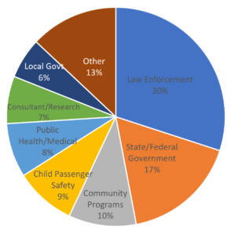

The Lifesavers Conference Program Committee is composed of roadway professionals and subject matter experts from across the country dedicated to reducing these tragedies. For this Reason, Lifesavers is recognized as the premiere conference to learn about the latest highway safety research, best practices, and cutting-edge initiatives; and to explore innovative technology and strategies used to combat risky driving behaviors and save lives. The Lifesavers Conference is also historically the world’s largest gathering of leaders and advocates in traffic safety. Now in its 42nd year, the Lifesavers Conference will take place April 7-9, 2024 in Denver, CO.
https://lifesaversconference.org/about/#

Slide 42

Held for 4 days during the summer, the Mid-Year Training Institute (MYTI) offers in-depth, interactive training sessions geared specifically for community coalition leaders and staff. MYTI also includes two levels of training for the National Youth Leadership Initiative activities (i.e., Key Essentials and Advanced). From fundamentals of coalition building and strategic planning to evaluation and research, you will walk away motivated and inspired. The MYTI is held in a different city each year in either late July or early August. This event will take place at Hilton Chicago, located in Chicago, IL from July 14-18, 2024. Registration details are forthcoming.

Slide 43
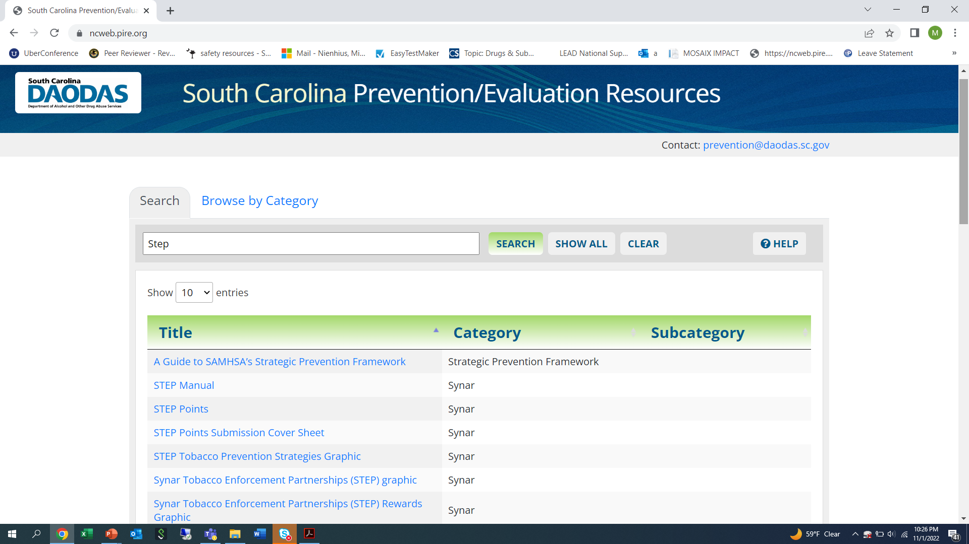

Slide 44

1801 Main Street, 12th Floor • Columbia, South Carolina 29201
telephone: 803-896-5555 • fax: 803-896-5558
www.daodas.sc.gov
Notes:
Final Slide

